Slide 1

Abstract Class Challenge
In this challenge, you need to build an application, that can be a store front, for any imaginable item for sale.
Instead of the Main class we usually create, create a Store class, with a main method.
The Store class should:
manage a list of products for sale, including displaying the product details.
manage an order, which can just be a list of OrderItem objects.
have methods to add an item to the order, and print the ordered items, so it looks like a sales receipt.
COMPLETE JAVA MASTERCLASS
Abstract Class Challenge Part 1

Slide 2
Abstract Class Challenge
Create a ProductForSale class that should have at least three fields: a type, price, and a description, and should have methods to:
get a Sales Price, a concrete method, which takes a quantity, and returns the quantity times the price.
print a Priced Line Item, a concrete method, which takes a quantity, and should print an itemized line item for an order, with quantity and line item price.
show Details, an abstract method, which represents what might be displayed on a product page, product type, description, price, and so on.
Create an OrderItem type, that has at a minimum 2 fields, quantity and a Product for Sale.
You should create two or three classes that extend the ProductForSale class, that will be products in your store.
COMPLETE JAVA MASTERCLASS
Abstract Class Challenge Part 1

Slide 3
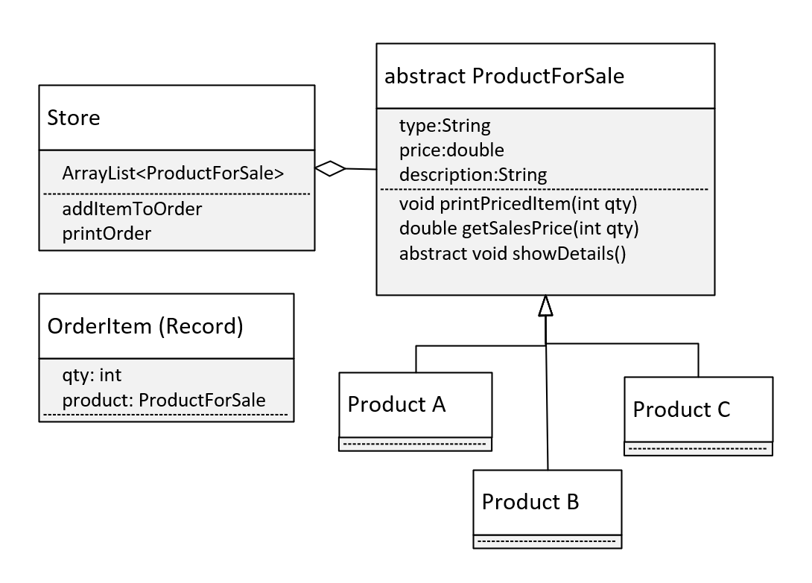
The Design
Let's look at my approach.
First, let me show you a class diagram, of what we'll be building.
This covers all the requirements we talked about.
You'll notice I'm specifying that OrderItem will be a record, and this is just to keep the code simple.
And I'm not really specifying what our store products are, we can really put anything there.
COMPLETE JAVA MASTERCLASS
Abstract Class Challenge Part 1

